Slide 1

SUSTAINABILITY OF THE WORLD
SUSTAINABILITY OF THE WORLD
NIKHITHA.K
21BDACC139

Slide 2
Table of content:
Food scarcity
With-without food
Healthy-unhealthy diet
Sources of food --lack of food sources
Water importance--pollution
Air importance--pollution
conclusion

Slide 3
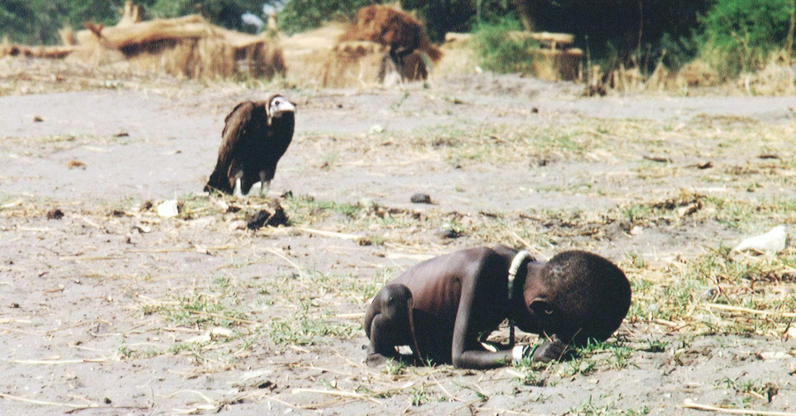
THE STRUGGLING GIRL

Slide 4
Kevin Carter’s iconic photograph of a starving Sudanese girl, who collapsed on her way to a feeding center while a vulture waited nearby, will always remain controversial because of the unintended suspense it creates.
Both the child and the vulture are still, but it’s a throbbing stillness, one that makes the viewer desperate for a second frame.
Logically, the composition suggests only two possibilities — either the vulture feasted on the child, which the viewer feels certain was only a matter of time when the photo was taken, or it did not.
But these possibilities don’t exist just as possibilities, they become loaded with emotion and turn into haunting questions.

Slide 5
In 1993, when the image was first published in The New York Times , most people turned to Carter, a South African photojournalist, for answers. The questions were not limited to the fate of the child but extended to Carter’s ethics.
Why did he stand around taking pictures instead of helping the child? The questions then turned into accusations. The St Petersburg Times (Florida) condemned him saying, “The man adjusting his lens to take just the right frame of her suffering might just as well be a predator, another vulture on the scene.”

Slide 6
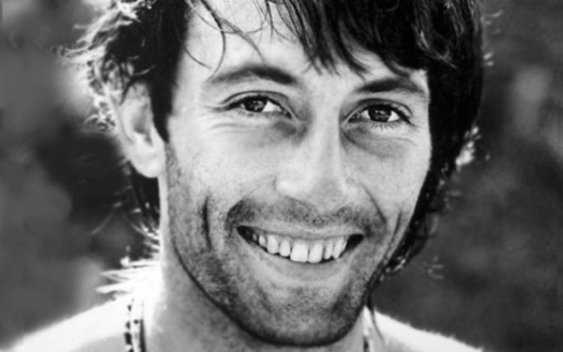
Kevin Carter was born in Johannesburg, South Africa, and grew up in a middle-class, whites-only neighbourhood .
As a child, he occasionally saw police raids to arrest black people who were illegally living in the area. He said later that he questioned how his parents, a Catholic, "liberal" family, could be what he described as 'lackadaisical' about fighting against apartheid.

Slide 7
The key of survival:
Food
Water
Air

Slide 8
With food…..
Food is an essential part of our lives. Not only does it provide us with the energy we need to go about our daily activities, but it also plays a critical role in maintaining good health. In this blog post, we will explore the different functions that food serves and how they contribute to our overall well-being.

Slide 9
The primary physiological function of food is to provide our bodies with the necessary nutrients to support life. These nutrients include carbohydrates, proteins, fats, vitamins, minerals, and water.
Carbohydrates, for example, provide us with energy, while proteins are essential for building and repairing tissues.
Fats are important for energy storage, while vitamins and minerals are required for various metabolic functions. Water is essential for maintaining the body’s fluid balance.
essential nutrients is critical for maintaining good health and preventing various diseases.
In addition to providing the necessary nutrients, food also serves other physiological functions. For example, it helps regulate our body temperature, maintain our fluid balance, and aid in digestion.

Slide 10
Sources of food…......
As mentioned earlier, food is anything that provides us with the necessary nutrition – food, IVs, supplements, etc.
Food can be easily obtained from agriculture, hunting, breeding, etc.
Food can directly be derived from plants or not – depends on your diet. That is, your nutrients can also be provided through animals – chicken, fish, lamb, etc.
Sometimes it doesn’t have to plants and animals, it can also be fungi or algae – mushroom. There are multiple bacteria and algae that are used to create alcohol, bread, cheese, etc.
Destruction in food sources may lead to food scarcity…..

Slide 11
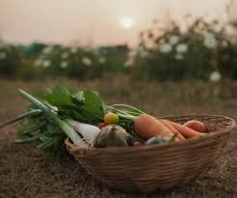
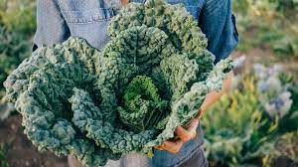
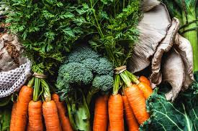
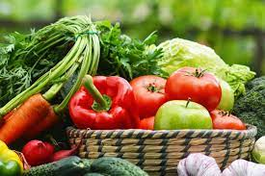
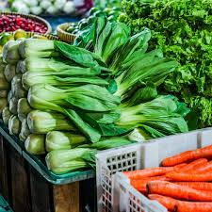
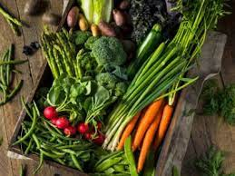
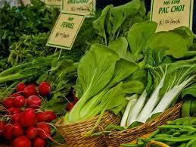
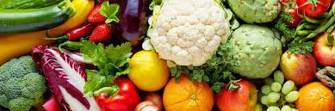

Slide 12
Healthy diet…..
It protects you against many chronic noncommunicable diseases, such as heart disease, diabetes and cancer. Eating a variety of foods and consuming less salt, sugars and saturated and industrially-produced trans-fats, are essential for healthy diet.
A healthy diet comprises a combination of different foods.
These include:
Staples like cereals (wheat, barley, rye, maize or rice) or starchy tubers or roots (potato, yam, taro or cassava).
Legumes (lentils and beans).
Fruit and vegetables.
Foods from animal sources (meat, fish, eggs and milk).

Slide 13
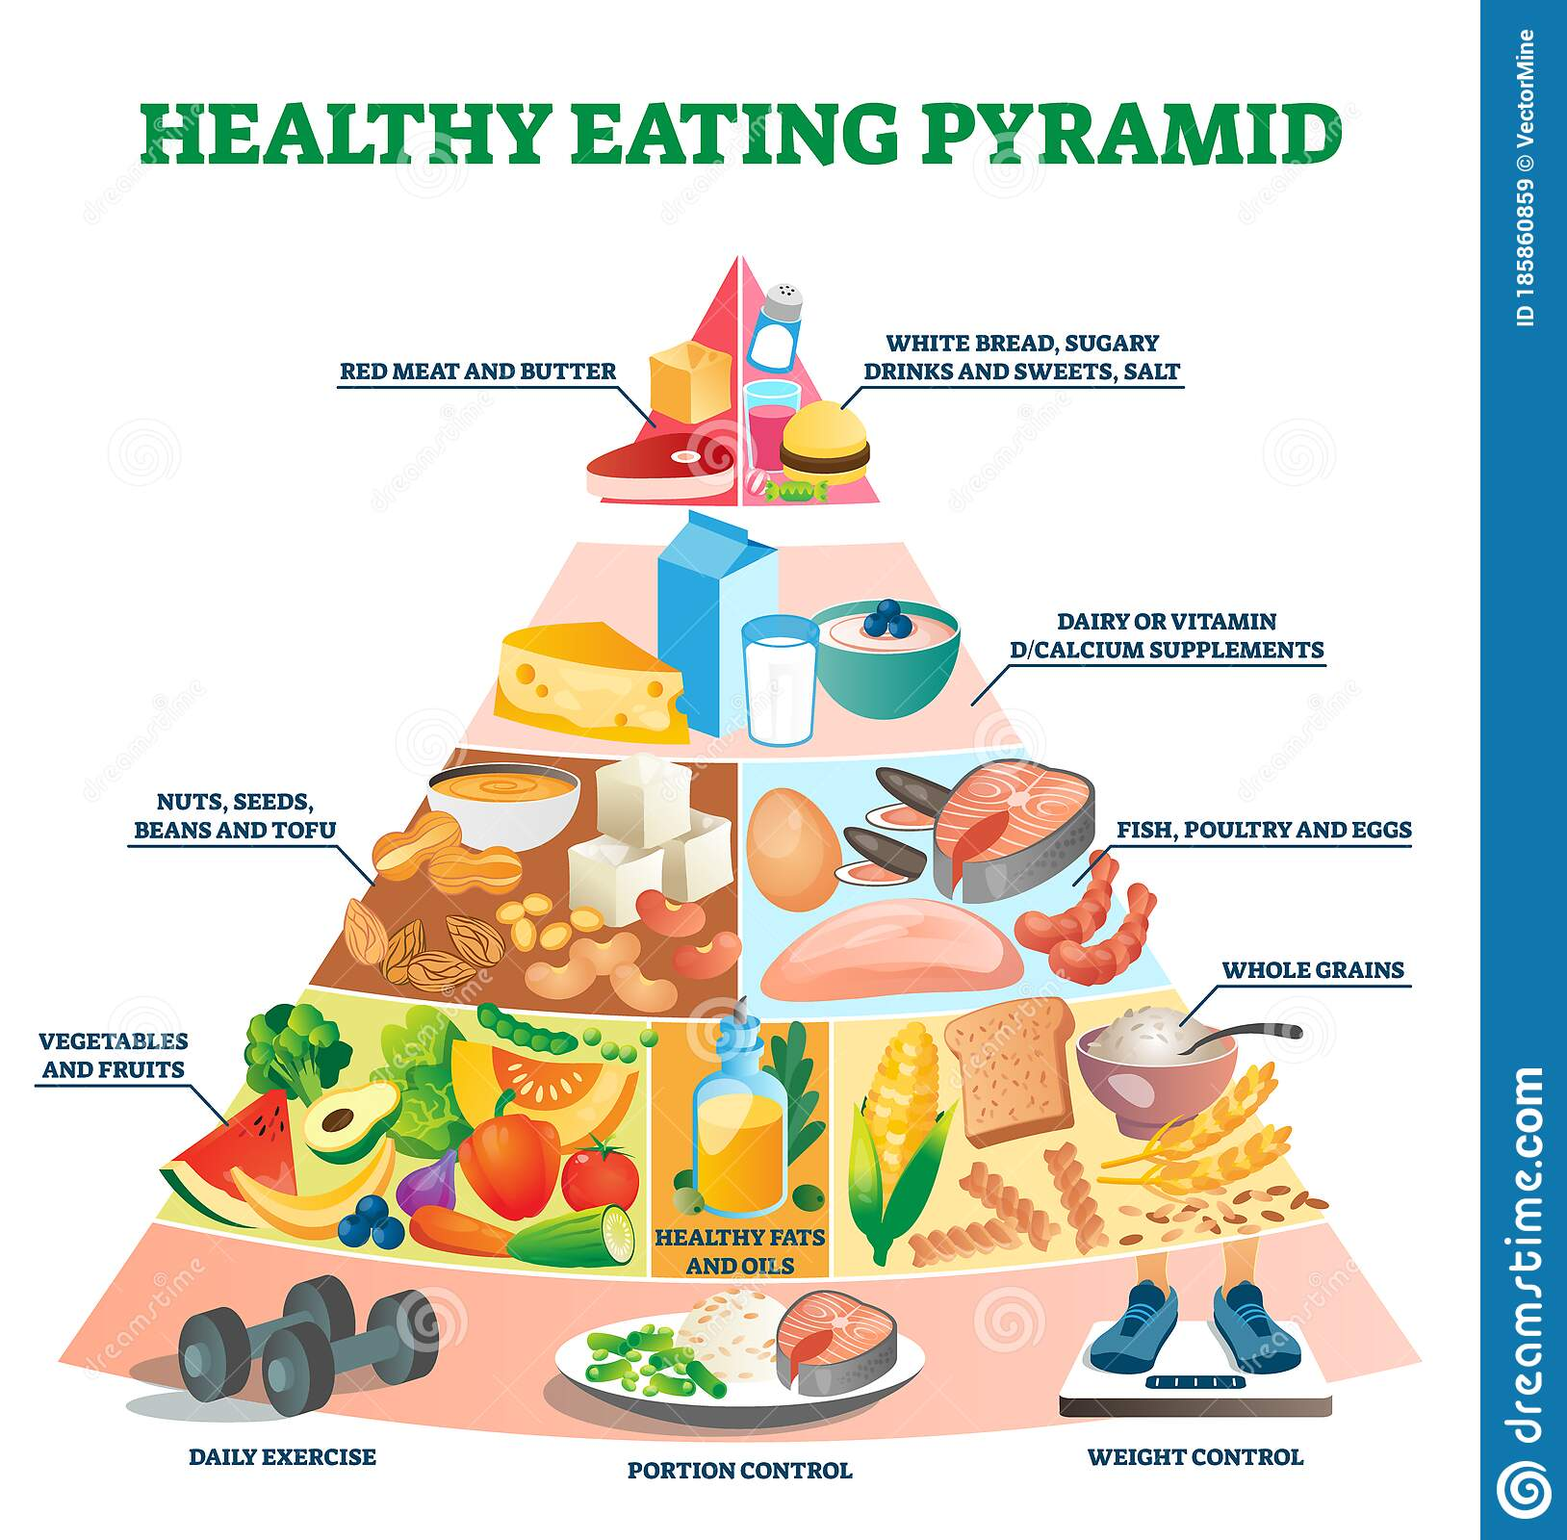

Slide 14
What if you are obsessed with junk food…..
Junk foods' are foods that lack nutrients, vitamins and minerals, and are high in kilojoules (energy), salts, sugars, and fats. Junk food is so called because it doesn’t play a role in healthy eating, especially if it's eaten to excess. Junk food is also known as discretionary food or optional food.
Some examples of junk food include:
cakes and biscuits
fast foods (such as hot chips, burgers and pizzas)
chocolate and sweets
processed meat (such as bacon)
snacks (such as chips)
sugary drinks (such as sports, energy and soft drinks)
alcoholic drinks
.

Slide 15
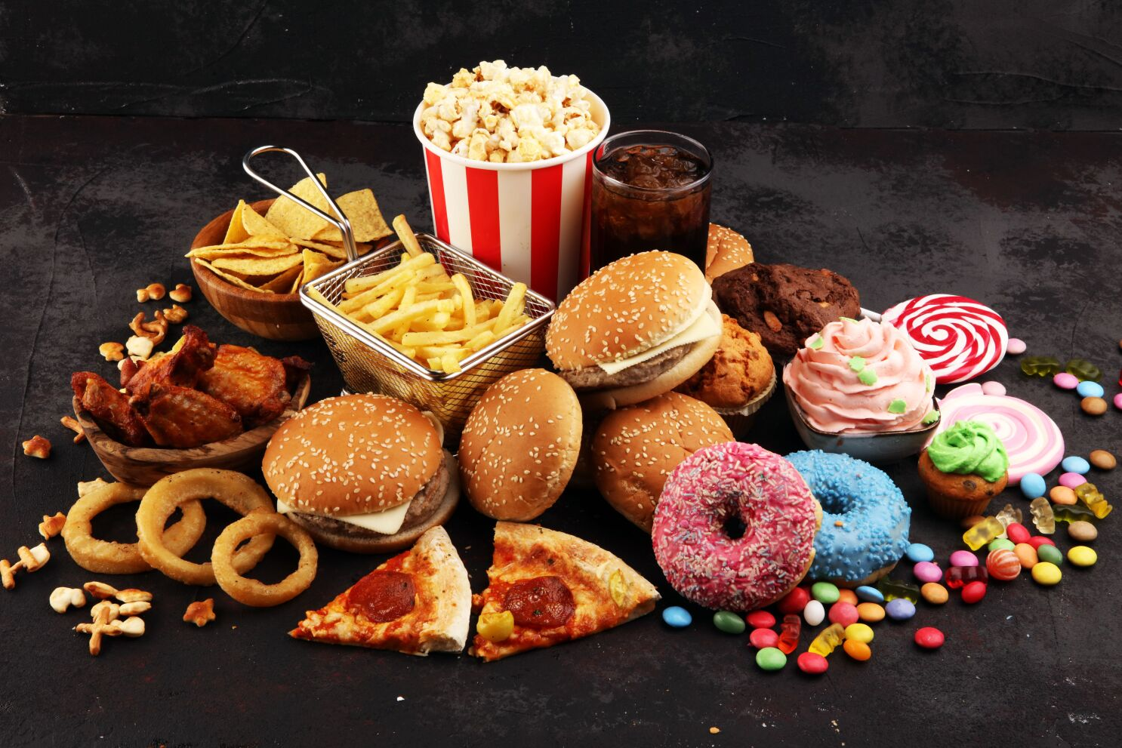
If your diet is high in fats, salt and sugar and is not receiving essential nutrients, your risk of obesity and other chronic (long-term) diseases may well increase.
These diseases include:
Cardiovascular diseases
type 2 diabetes
non-alcoholic fatty liver disease
a number of cancers
And also….
increased stress levels
fatigue
difficulty sleeping
deceased energy levels
concentration difficulties
feeling down
tooth decay

Slide 16
What if you lack food sources……
Food insecurity has been defined as a lack of consistent access to enough food for an active and healthy life. In other words, there are millions of people all over the world who suffer from a shortage of food and cannot tell if they will be able to feed themselves the next day or at the end of the day. This is the basis of defining food insecurity.

Slide 17
In 2018, for example, it was reported that 1 in 9 Americans suffered from food insecurity. That is equivalent to 37 million people, more than 11 million of whom are children. Hunger and food insecurity are closely related, and it is possible to say that when one is food insecure, they will be hungry. Hunger will lead to poverty and diseases, although not all people living below the poverty line experience food insecurity because those living above the poverty line could also experience food insecurity.
Food insecurity is a dangerous concept as it does not exist in isolation. Low-income families could be affected by multiple overlapping issues such as social isolation, acute and chronic health problems, the lack of affordable housing, low wages, and high medical costs, among others. These factors could also result in food insecurity and vice versa, making it a complex and more dangerous state of life.

Slide 18
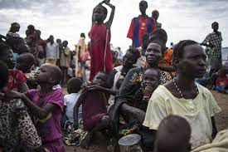
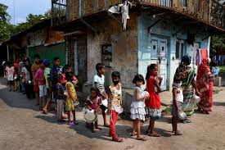
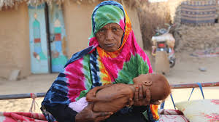
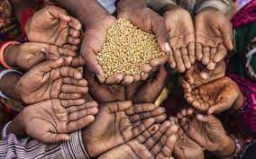
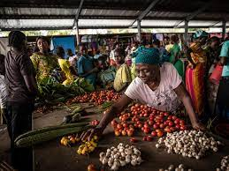
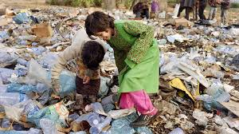
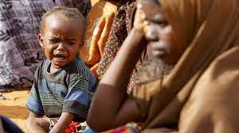
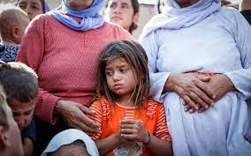
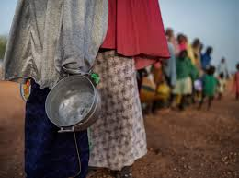
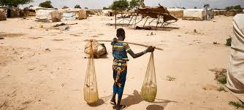

Slide 19
Without food
A severe lack of food for a prolonged period — not enough calories of any sort to keep up with the body's energy needs — is starvation. The body's reserve resources are depleted. The result is substantial weight loss, wasting away of the body's tissues and eventually death.
When faced with starvation, the body fights back. The first day without food is a lot like the overnight fast between dinner one night and breakfast the next morning. Energy levels are low but pick up with a morning meal.
Within days, faced with nothing to eat, the body begins feeding on itself. "The body starts to consume energy stores — carbohydrates, fats and then the protein parts of tissue," says Maureen Gallagher, senior nutrition adviser to Action Against Hunger, a network of international humanitarian organizations focused on eliminating hunger. Metabolism slows, the body cannot regulate its temperature, kidney function is impaired and the immune system weakens.

Slide 20
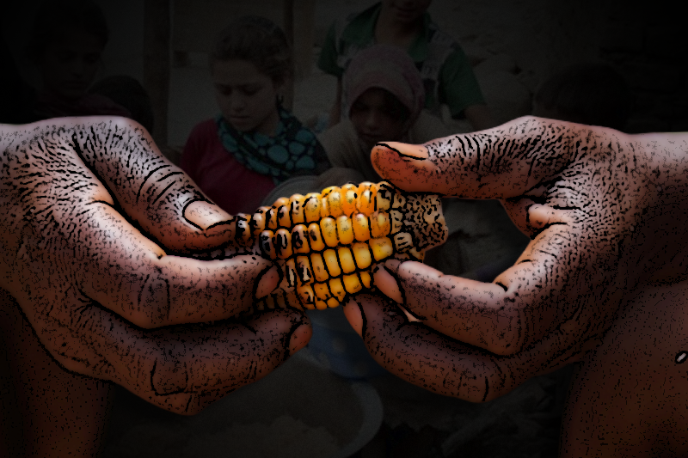
When the body uses its reserves to provide basic energy needs, it can no longer supply necessary nutrients to vital organs and tissues. The heart, lungs, ovaries and testes shrink. Muscles shrink and people feel weak. Body temperature drops and people can feel chilled. People can become irritable, and it becomes difficult to concentrate.

Slide 21
AQUA---VALUE
All plants and animals need water to survive. There can be no life on earth without water.
Why is water so important? Because 60 percent of our body weight is made up of water. Our bodies use water in all the cells, organs, and tissues, to help regulate body temperature and maintain other bodily functions.
Because our bodies lose water through breathing, sweating, and digestion, it's crucial to rehydrate and replace water by drinking fluids and eating foods that contain water.

Slide 22
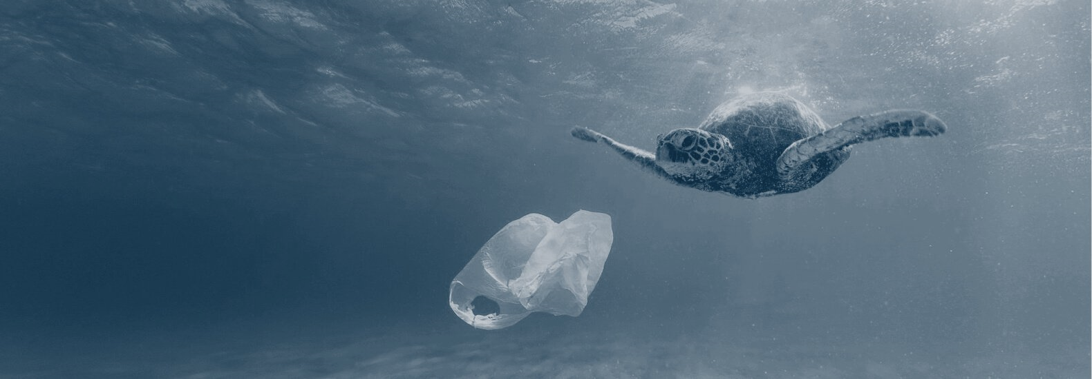
AQUA---POLLUTION
Water pollution is the contamination of water sources by substances which make the water unusable for drinking, cooking, cleaning, swimming, and other activities.
Pollutants include chemicals, trash, bacteria, and parasites. All forms of pollution eventually make their way to water.
Sources Of Water Pollution
Urbanization.
Deforestation.
Industrial effluents.
Social and Religious Practices.
Use of Detergents and Fertilizers

Slide 23
WHAT WITHOUT AIR…????
We all need oxygen for respiration. The animals that live both on land and even the aquatic animals need oxygen to exist otherwise they would all perish. Air is the fundamental building block, apart from which life itself would not exist.

Slide 24
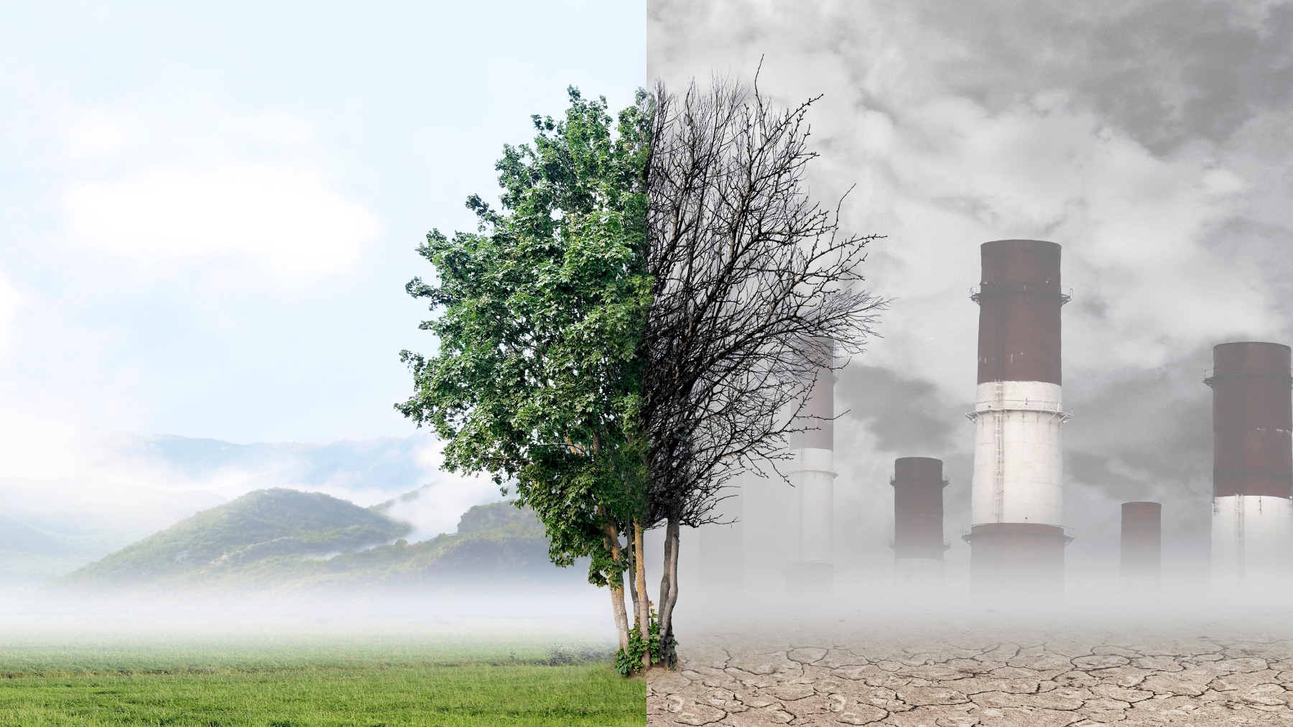

Slide 25
We use oxygen all the time but it is still not exhausted because trees return this oxygen to the atmosphere during the process of photosynthesis.
Plants also consume oxygen but their consumption is very less than compared to their production. Hence, the net effect is that they add oxygen to the atmosphere.
Animals and plants are interdependent on each other for their survival, plants produce oxygen and animals produce carbon dioxide as a by the process, thus they exist with one other forming an ecosystem of their own.
However, due to man-made contributions to the environment and ecosystem such as deforestation and factories that release smog, smoke, and other chemical components into the air, thereby polluting the air. This is called Air Pollution.

Slide 26
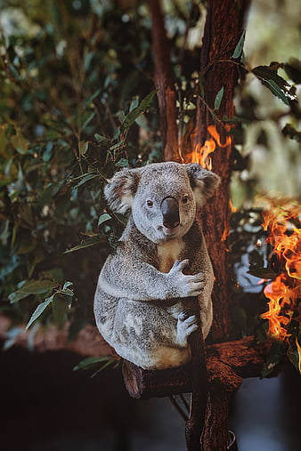
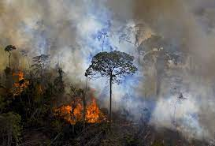
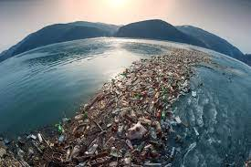
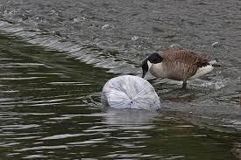
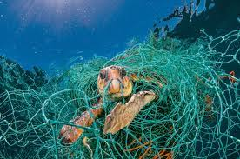
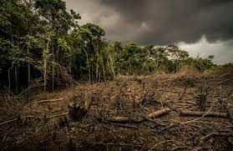
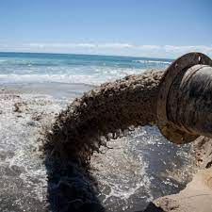
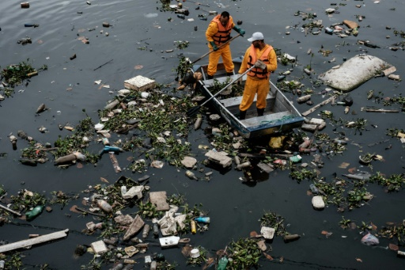
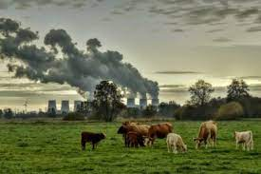
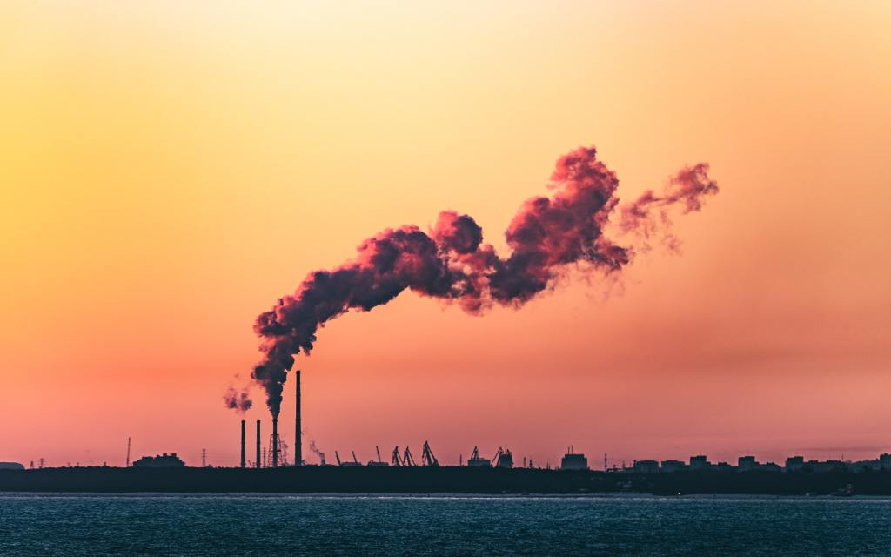

Slide 27
CONCLUSION
As you know all the living creatures depend on each other for survival…even one single fall in that connection would entirely effect the living beings…but the most clever creatures humans are the main reason behind this big mistake.. they utilize the nature with greed and not leave anything for other lives.. they pollute the nature and make others life miserable.. Without food , water and fresh air many lives are suffering ,each year around 3.1 million children are dying due to lack of food and water…Protect them and the mother nature…
Remember not to waste food and try to help others…

Slide 28


Slide 29
“ Try to leave the Earth a better place than when you arrived.”
~Sidrey Sheldon

Slide 30


THANK YOU
: NIKHITHA.K

